Slide 1
Storytelling Case Study – Airbnb, NYC By: Meenakshi Sharma, Pranav keshav sairipally and Manu Smriti

Slide 2
AGENDA
Objective
Background
Insights
Inference
Appendix
Data Assumptions
Data Methodology

Slide 3
Objective
Improve business strategies and estimate customer preferences to revive the business in the post-COVID period.
Analyze the critical pre-COVID period of Airbnb's business in NYC.
Make recommendations to various departments on how to prepare for post pandemic changes.

Slide 4
Background
Airbnb’s revenue has been significantly reduced in recent months as a result of COVID-19.
People have begun to travel more now that the restrictions are lifted.
Airbnb wants to make sure that it is fully prepared for this change.

Slide 5
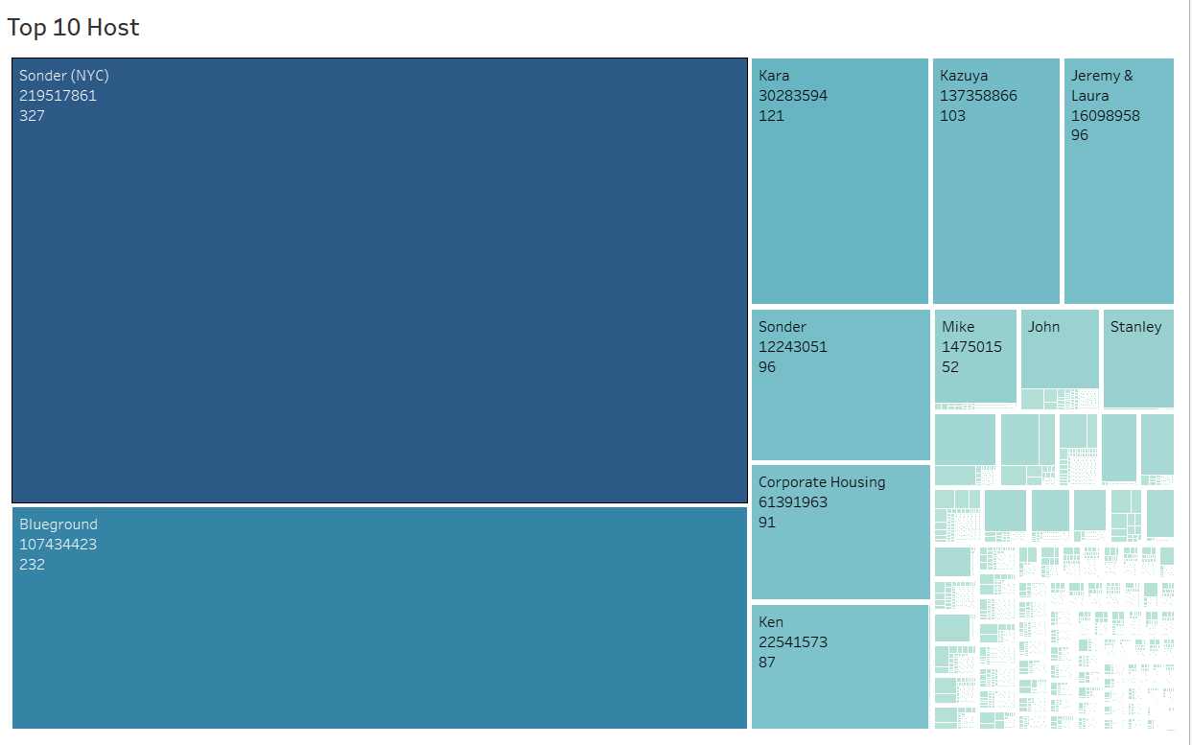
To 10 Hosts by number of listings in airbnb
Host sonder (id 219517861), has been booked most number of times i.e. 327.
Host Blue ground is the second popular host.
Then there are other hosts like Kara, Ken, Corporate Housing, Jeremy and Mike that fall under top 10 hosts.

Slide 6
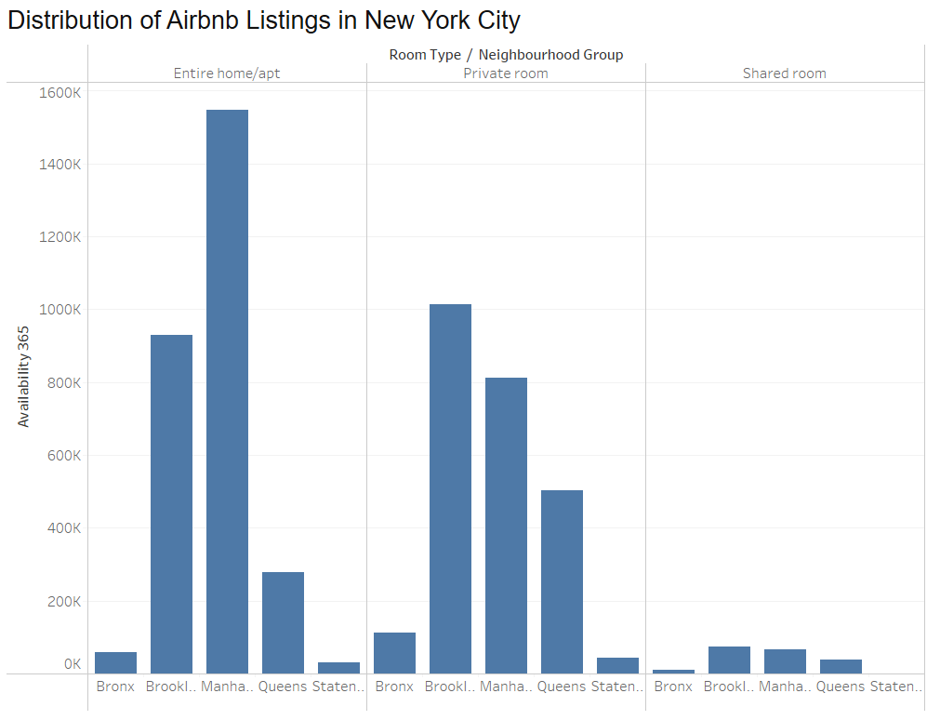
Distribution of Airbnb Listings in New York City
Manhattan and Brooklyn dominate in the number of available Entire home/apartment listings.
Private rooms have significant availability in Brooklyn and Manhattan, while queens also shows a noticeable presence.
Shared rooms have the least availability across all neighborhood groups, with a slight presence in Brooklyn.

Slide 7
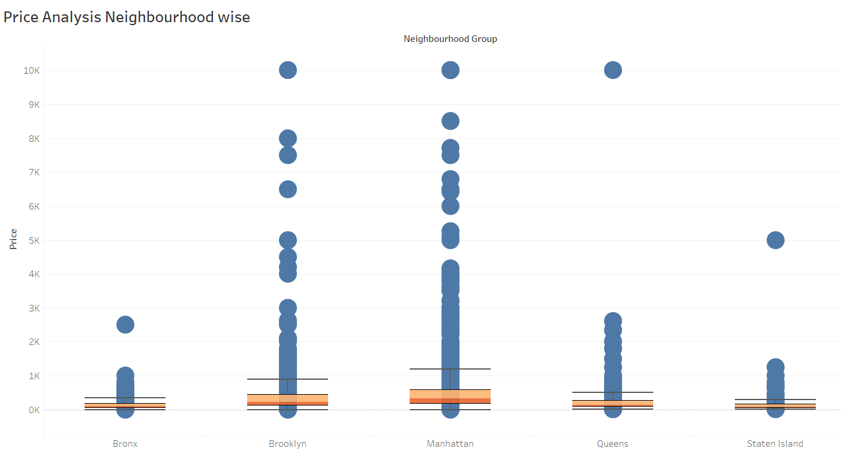
Price Analysis neighborhood wise
Manhattan leads in terms of both the median price and the number of high-end outliers.
Brooklyn follows with moderate pricing and fewer extreme outliers.
The Bronx and Staten Island show the lowest price distributions. The IQR and median prices are significantly lower compared to Manhattan and Brooklyn.

Slide 8
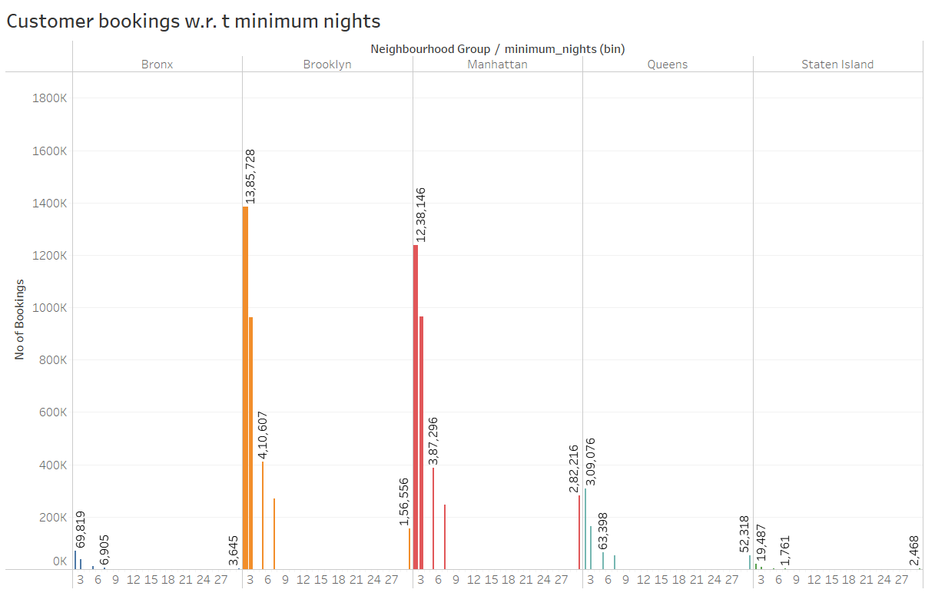
Analyzing Customer Bookings Based on Minimum Night Stays in NYC
The listings with Minimum nights 1-5 have the most number of bookings. We can see a prominent spike in 30 days, this would be because customers would rent out on a monthly basis.
After 30 days, we can also see small spikes, this can also be explained by the monthly rent taking trend.
Manhattan and Brooklyn have higher number of 30 day bookings compared to the others.

Slide 9
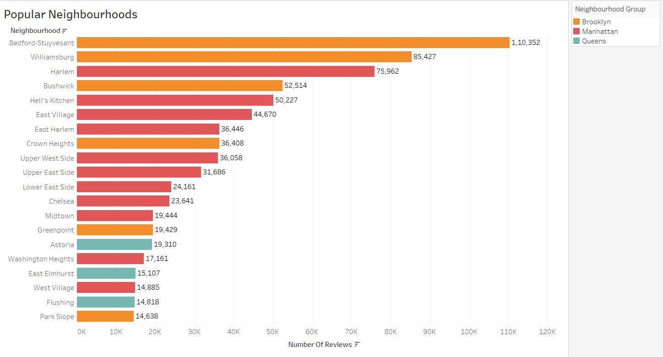
Popular neighborhoods
Brooklyn dominates with the highest number of reviews, especially in Bedford-Stuyvesant and Williamsburg.
Manhattan and Brooklyn neighborhoods have high user engagement and popularity as compared to Queens, which has fewer reviews.
The Airbnb properties in Brooklyn and Manhattan are more frequently reviewed, possibly indicating higher demand or customer satisfaction.

Slide 10
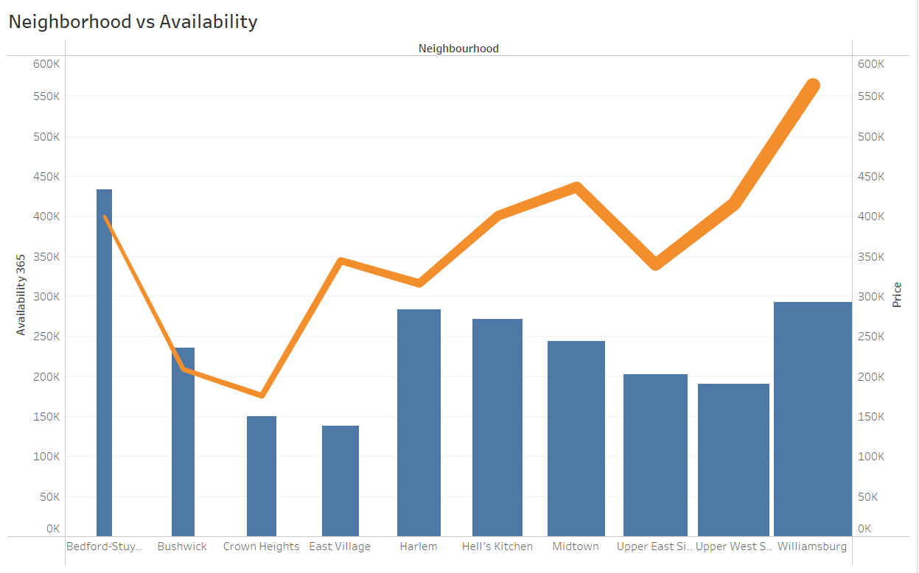
Comparison of neighborhood availability and average prices
Availability of Bedford is highest and its price is on the lower side. It is a good choice for customers.
Neighborhoods like Bushwick and Crown Heights have moderate availability and relatively lower prices.
On the other hand, William’s price is high and has average availability.

Slide 11
Inference
The number of reviews is higher at lower-priced properties than at higher-priced properties as people are less likely to book expensive rooms.
Most of the listed properties are private rooms and complete homes/apt, which also account for the majority of the total price share.
Expensive prime locations like Manhattan and Brooklyn can be targeted for non premium properties and Bronx for premium properties.
The minimum number of nights to stay decreases with an increase in price.
Property host Maya from Queens has the highest number of total reviews.
Most popular listings have a minimum number of nights stay requirement ranging from 1 to 5 nights or 30 nights.
Acquire private rooms and entire home/apartments since they are more popular room type having more number of reviews per listing.

Slide 12
Appendix : Data assumptions
Assumed that pre-pandemic data was generating the desired revenue.
To learn about customer preferences, used the number of reviews per listing as a popularity metric.
Assumed number of reviews provided to be positive to use as a base measure to find customer preferences.
Assumed that company does not wish to expand into new markets in NYC.
Null values are assumed to have no effect on the analysis.

Slide 13
Appendix : Data Methodology
Used Tableau to visualize data from the NYC Airbnb dataset in order to obtain accurate insights.
Python is utilized for performing Exploratory Data Analysis (EDA) to understand and summarize key patterns in the dataset.
Checked the dataset for null values. Some columns, such as names, host_name, last_review, and reviews_per_month, had null values.
Check the data type of columns and change the data type as required.
Created features from various columns –
Categorize the “availability_365” column into 5 categories – very low, low, medium, high and very high. Similarly Categorize the “Price”, “Number_of_reviews” and “Minimum_nights” columns.

Slide 14
Appendix : Data Methodology
Used group aggregation, Pivot table and other statical methods.
Perform the univariate, bivariate and multivariate analysis on data.
Exploratory data analysis was used to identify customer preferences based on various parameters such as area preferences, property prices, and listing preferences.
Checked the dataset for outliers.

Slide 15
Thank you

